Slide 1
Welcome to the King Career Center
February 16, 2017
MECAC

Slide 2
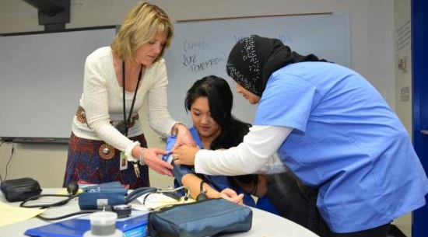
Our Mission
The mission of the King Career Center is to prepare students for entry level positions in career fields and post-secondary education or training.

Slide 3
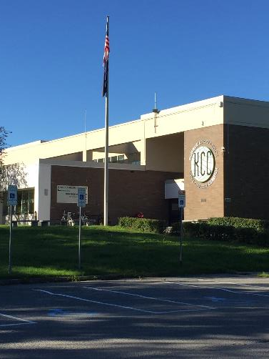
A Brief History
The Career Center opened doors, fall 1974.
January 1989, the name changed to Martin Luther King, Jr. Career Center, or KCC.

Slide 4
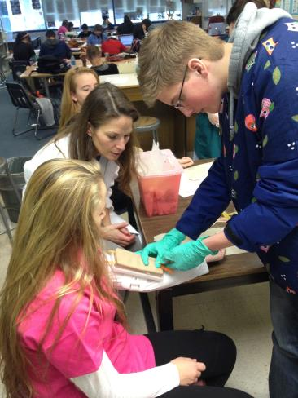
Students, Faculty, and Programs

Slide 5
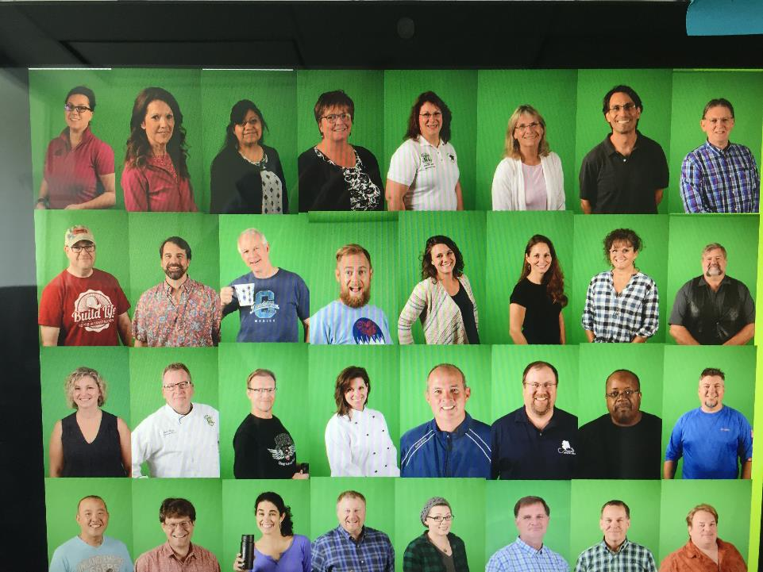

Slide 6
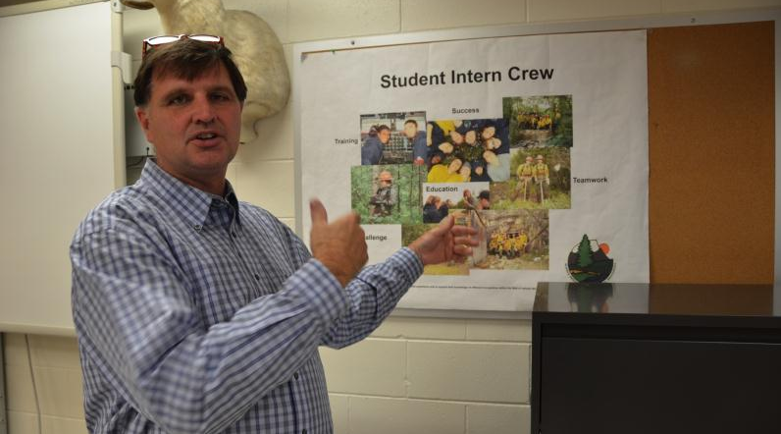
Faculty Members:
Dual Professions — Industry and Education

Slide 7
KCC Vs. District
Alaska Native 123 10%
American Indian 13 1%
Asian 113 9%
Black 78 6%
Hispanics 137 11%
Multi-Ethnic 120 10%
N. Haw/Pac. Is. 53 4%
White 576 47%
Alaska Native 7.6%
American Indian .06%
Asian 12%
Black 6%
Hispanics 11%
Multi-Ethnic 13%
N. Haw/Pac. Is. 5.44%
White 44%

Slide 8
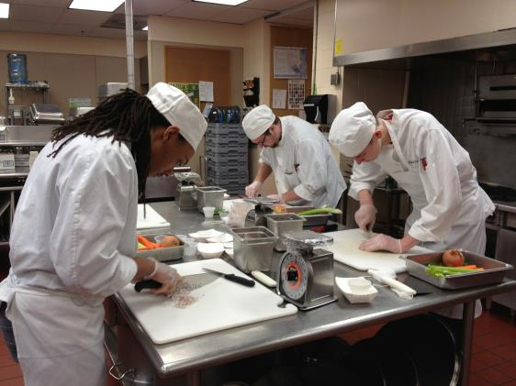
3 TYPES OF GRADUATES
Directly into Workforce in Pathway of Study
Post-secondary Education/training in Pathway
Undecided but with Foundation and Transferable Skills

Slide 9
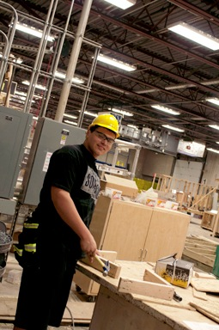
All programs deliver to varying degrees academic, technical, and transferrable soft skills.

Slide 10

Deliverables
Connection to and Guidance from Industry
Soft Skills
Excellent Instruction
Industry Certifications (varies class to class)
College Credit through Tech Prep Agreements
High Expectations
OJT, Internships, Job Shadow Opportunities
Entry-Level Job Readiness
Hiring Events
Career and Scholarship Portfolios

Slide 11
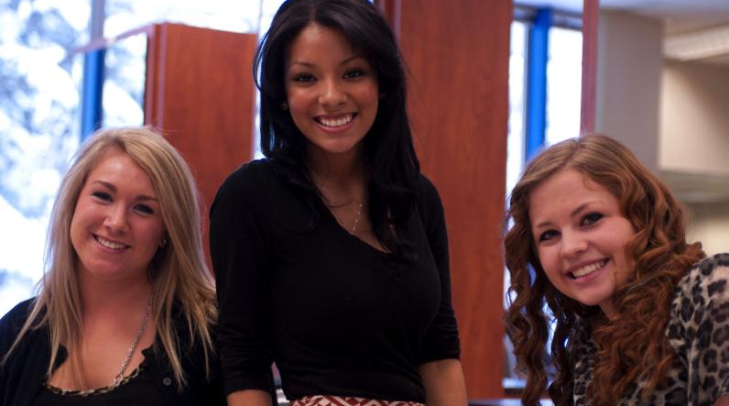
We are a “Shared-Time School”; nearly all of our students attend another school.

Slide 12
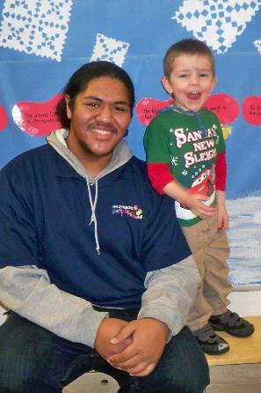
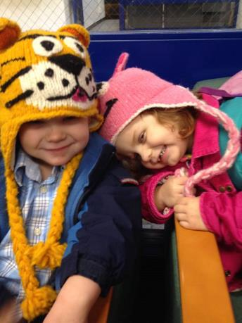
A FEW OF OUR PROGRAMS…
Early Childhood Education

Slide 13
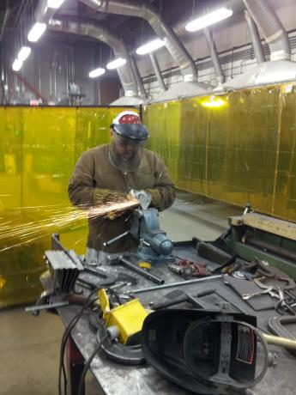
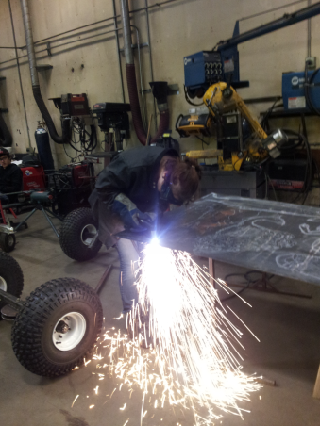
WELDING

Slide 14
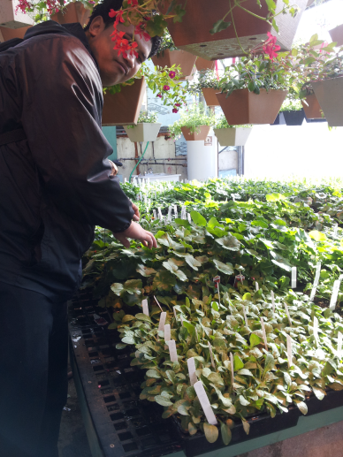

HORTICULTURE

Slide 15
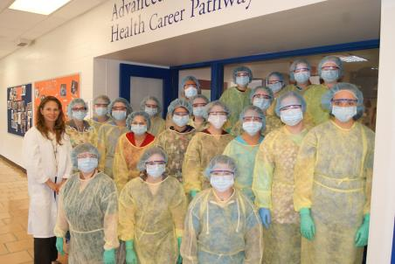
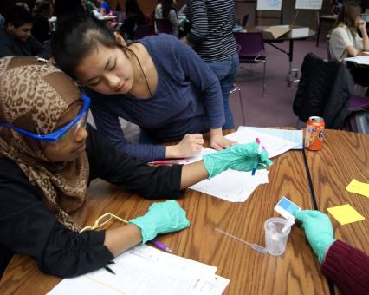
ADVANCED HEALTH CAREER PATHWAYS

Slide 16
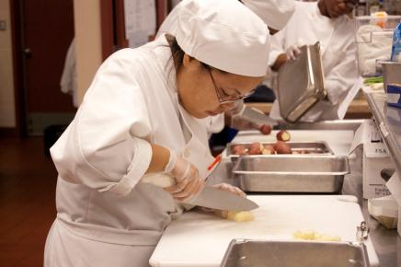
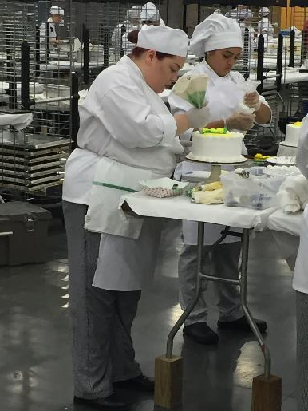
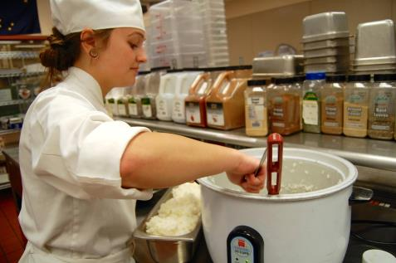
CULINARY ARTS

Slide 17
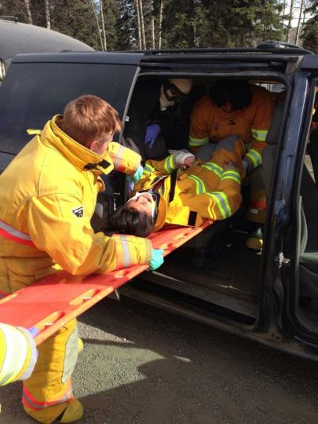
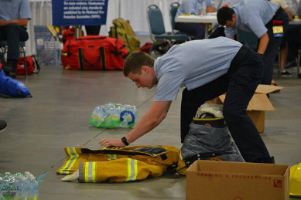
FIRE RESCUE PRACTICES

Slide 18
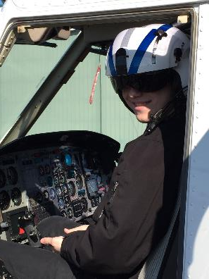
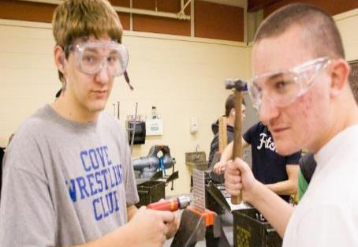
AVIATION Maintenance
AVIATION Technology

Slide 19
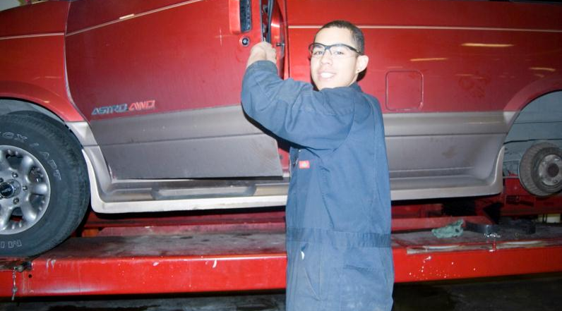
AUTOMOTIVE MAINTENANCE

Slide 20
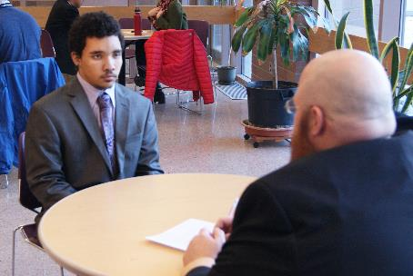
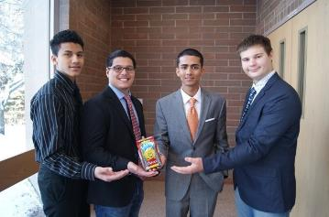
Entrepreneurship and Enterprise

Slide 21
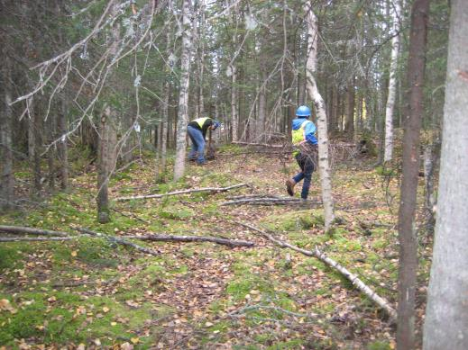
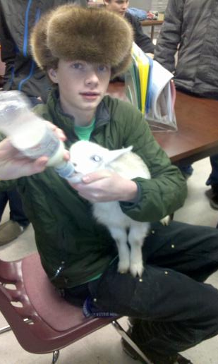
NATURAL RESOURCES MANAGEMENT

Slide 22
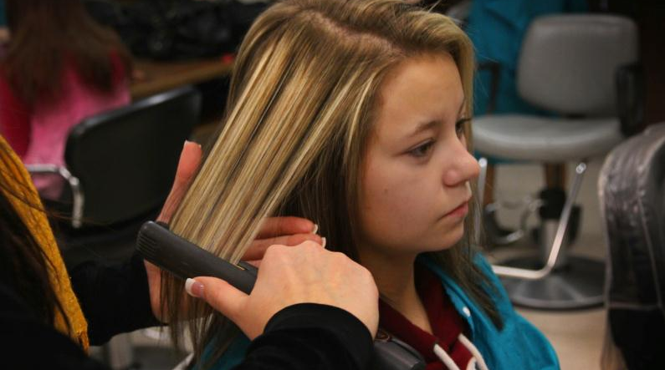
COSMETOLOGY

Slide 23
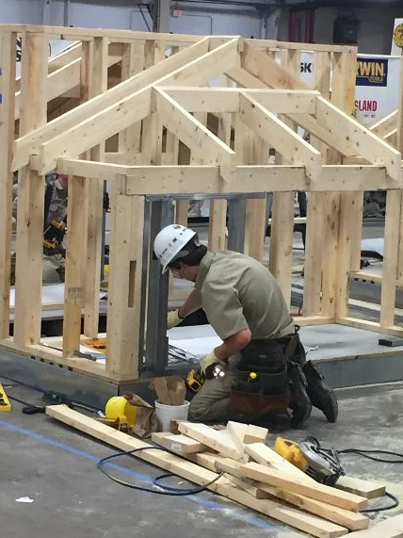
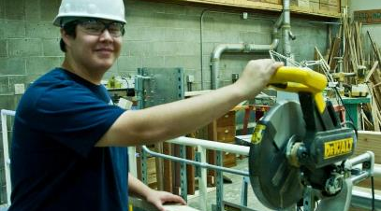
CARPENTRY

Slide 24
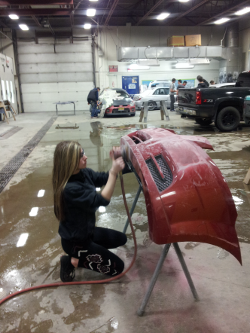
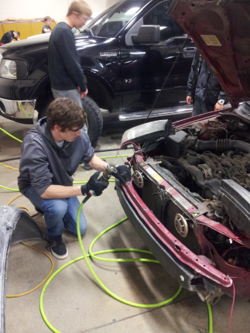
COLLISION REPAIR AND REFINISHING

Slide 25
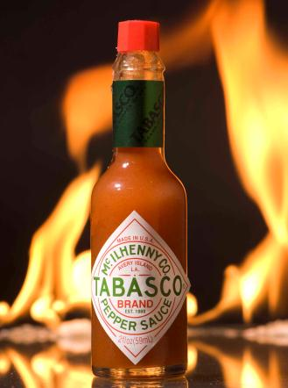
ADVERTISING, ART, AND DESIGN

Slide 26
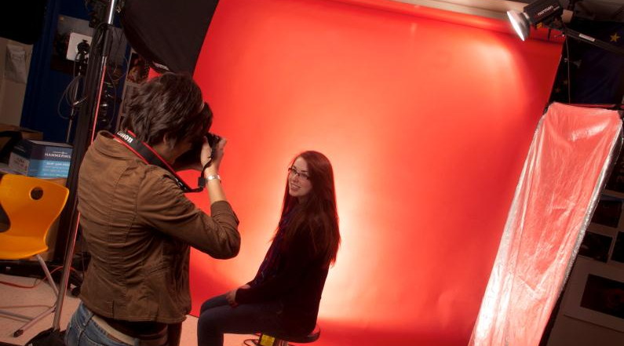
Visual Media and Communication

Slide 27
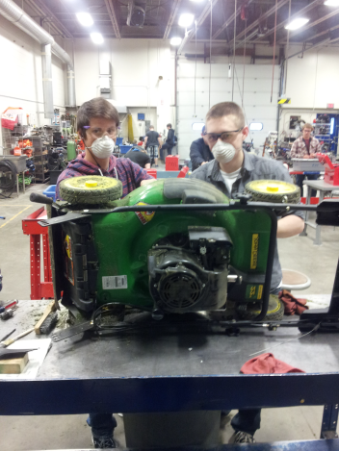
OUTDOOR POWER EQUIPMENT

Slide 28
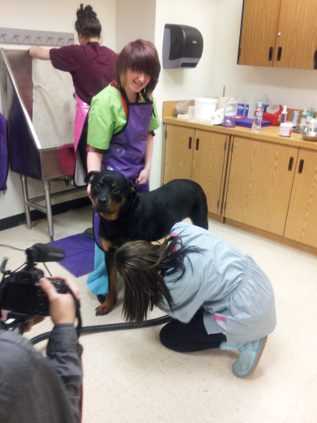
VETERINARY SCIENCE

Slide 29
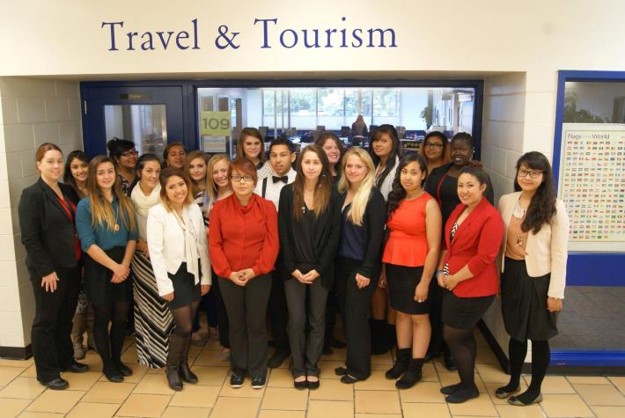
Travel and Tourism

Slide 30

Professionalism – A KCC Expectation
25% of the grade
Soft Skills: Attitude, Punctuality, Attendance, Work Ethic, and Interpersonal Skills
Industry Driven
Employability
Thank you parents for reinforcing the expectations.

Slide 31
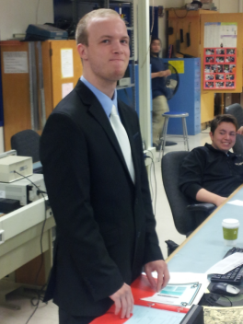
From students:
Attendance and Punctuality
Appropriate Dress (Wednesday Prof. Dress Day)
Commitment
and…Attitude – Pleasant and Worklike

Slide 32
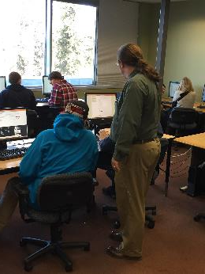
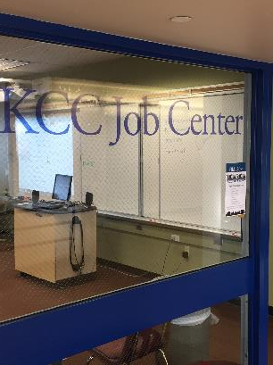
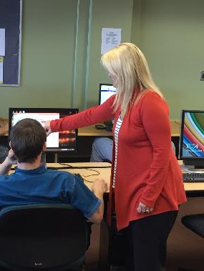
KCC Job Center

Slide 33
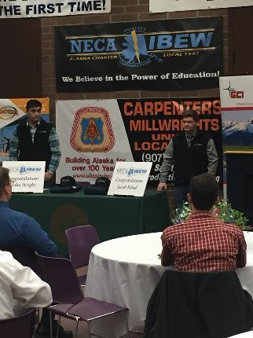
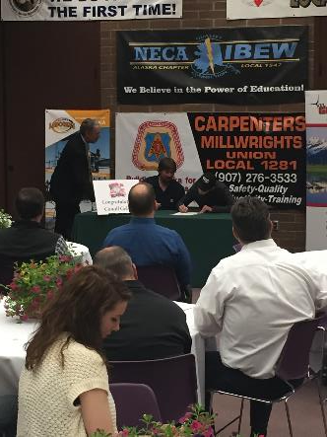
And it’ll happen… Just a few examples
IBEW
Josh & Jacob
Conall
Sheet Metal Workers

Slide 34
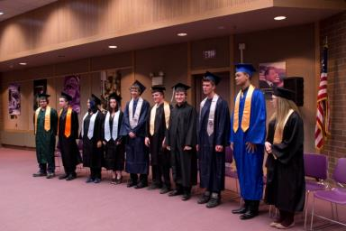
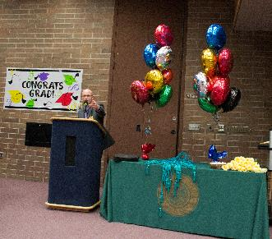
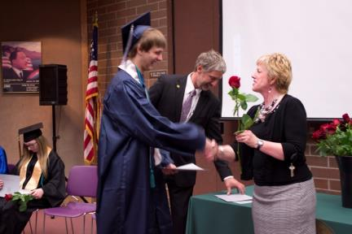
And for a fortunate Few…
…We have full day KCC!
*½ day KCC class
*½ day online core credits
*KCC Graduation

